Slide 1
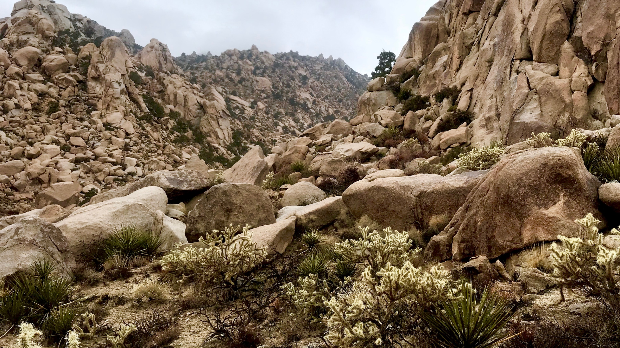
Pollination and Seed Dispersal of Cactaceae by Avian Interactors
Malory Owen & Christopher Lortie
Spring 2019 Progress Report

Slide 2
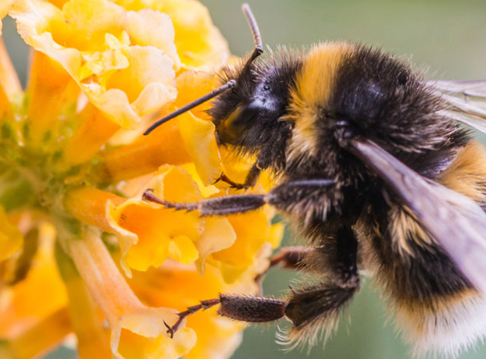
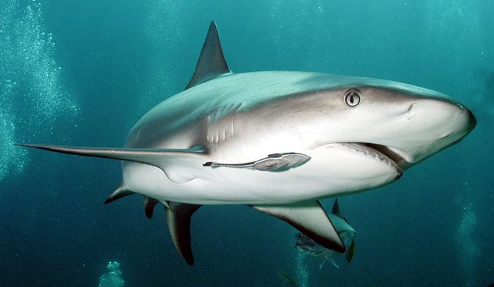
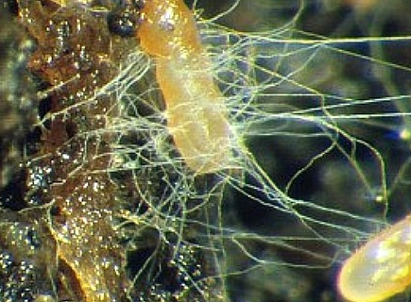
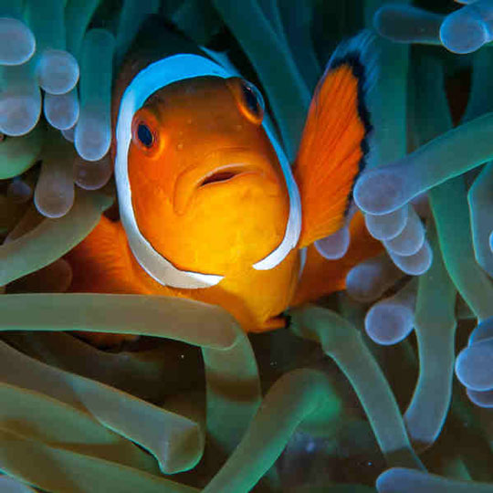
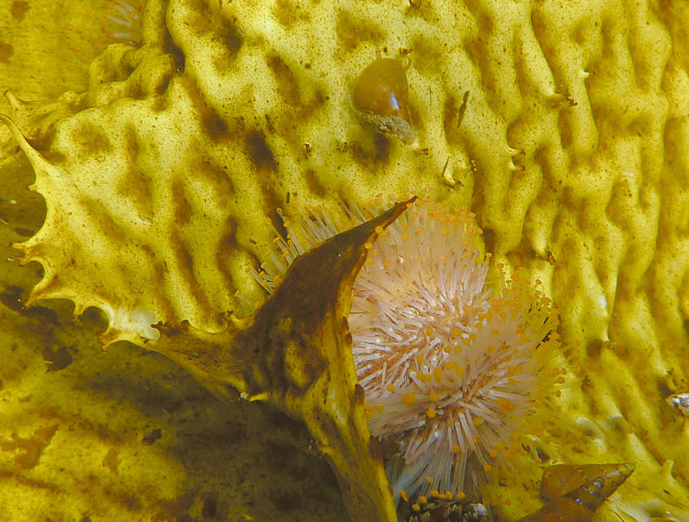
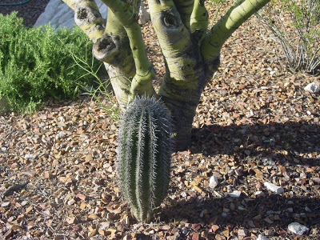
Shark and remora, shrub and cactus, clownfish and anemone,, mycorrhizae, bee and flower, kelp, gastropod, and sea urchin
Notes:
Any association between two or more individuals where at least one individual has a benefit to its health, fitness, or survivability and neither is negatively impacted (although, adjacent competition may occur alongside positive interactions).
Positive interactions take many forms.
Pathways

Slide 3
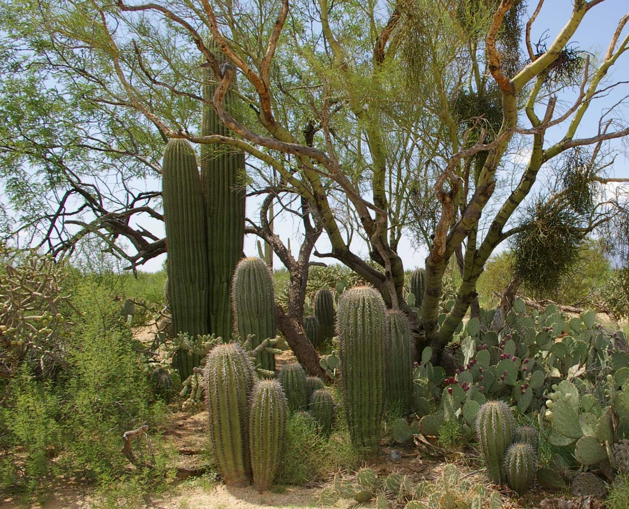
Facilitation: change your environment, change your life!
plant

Slide 4
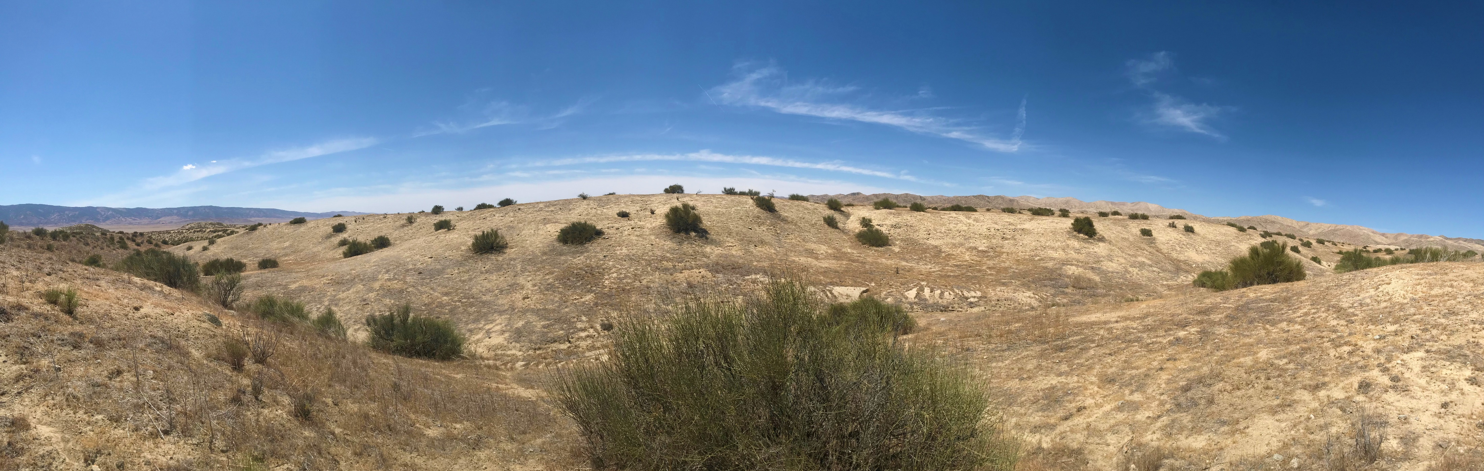
Foundational Species
Notes:
When a species facilitates many other species in an ecosystem and becomes a dominant species, it’s known as a foundational species. Shrub species documented as the most common benefactor plant species globally (above is Ephedra californica).

Slide 5
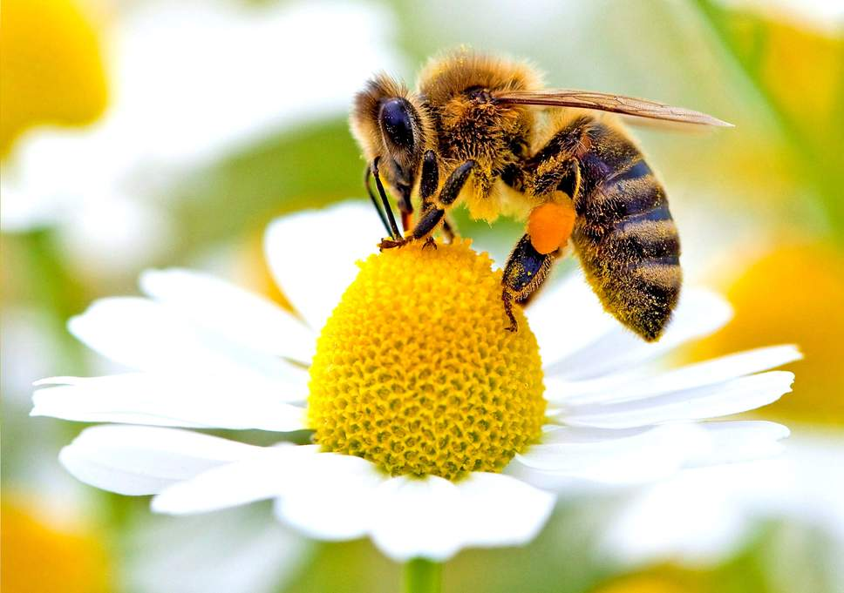
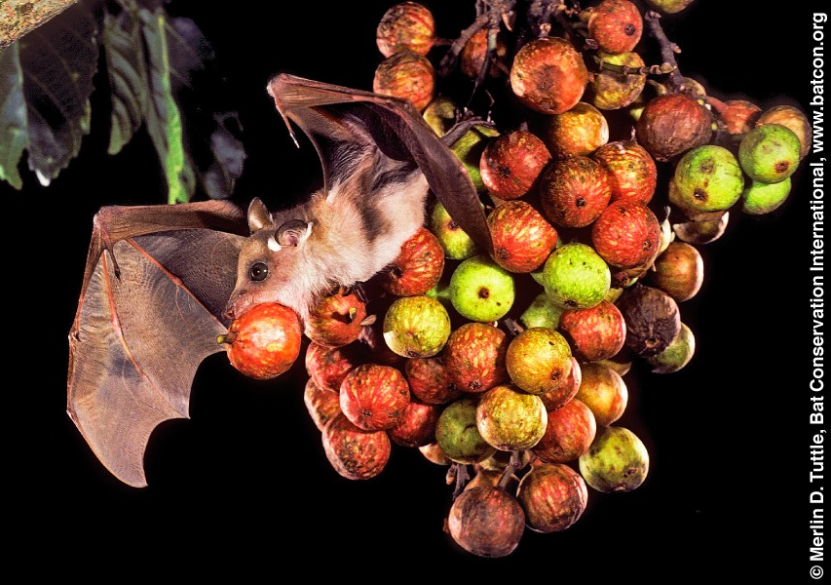
(Single) Mutualism
Bat, bee
Notes:
Single mutualism: when an interaction is positive for both interacting species.
Ex: bee pollinating flower, fruit bat eating fruit and dispersing seeds

Slide 6
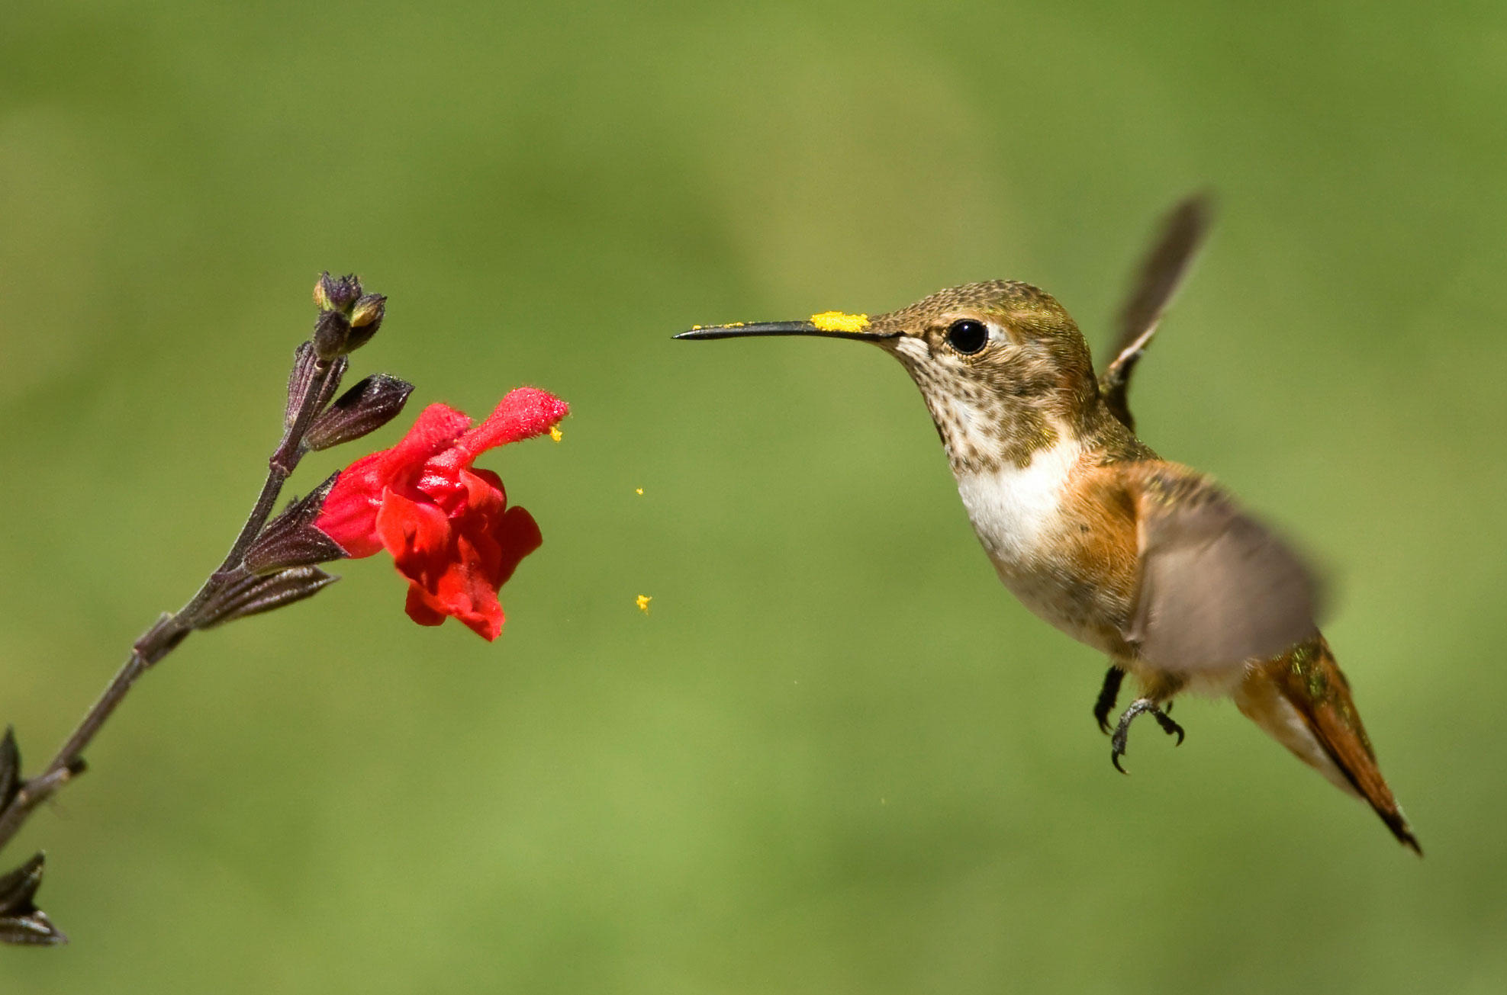
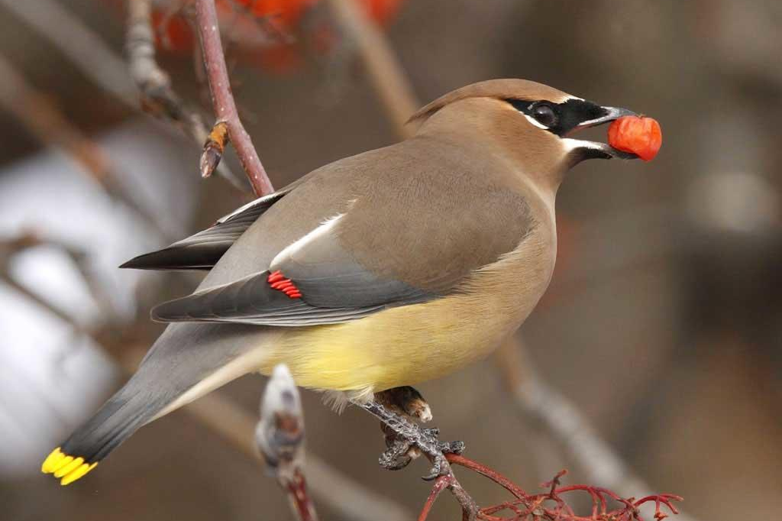
Same location
Same species
Double Mutualism
Hummingbird, waxwing
Notes:
Double mutualism;
When one taxa, in same habitat, performs dual services: pollination and seed dispersal
Most common in “harsh” climates: islands/deserts.
Cacti, being foundational ssp in deserts, may be utilizaing double mutualism…

Slide 7
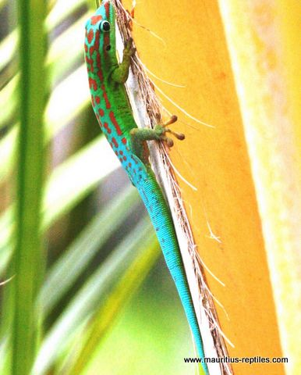
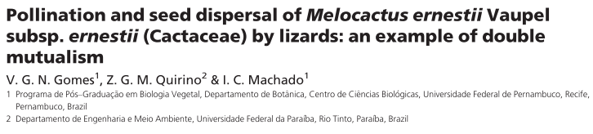
Phelsuma cepediana

Slide 8



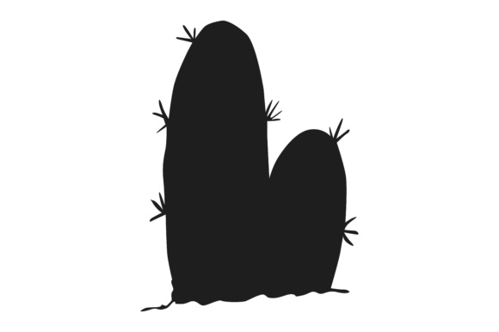



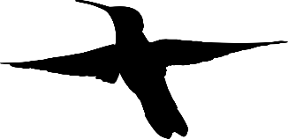
Notes:
So what is an advantageous adaption for cactus? Showier displays (more flowers) attract more pollinators/seed dispersers. Higher inflorescenses attract more pollinators/seed dispersers (flying individuals).
Foragers in patchy ecosystems function under marginal value theory where they will forage in one spot until the resource availability at that spot is equal to/lower than the entire habitat’s resource availability (then they will move on). This value is known as Giving Up Density (GUD). This leads us to believe cacti will produce many flowers/fruits, and be very tall. However, this isn’t the whole picture…

Slide 9

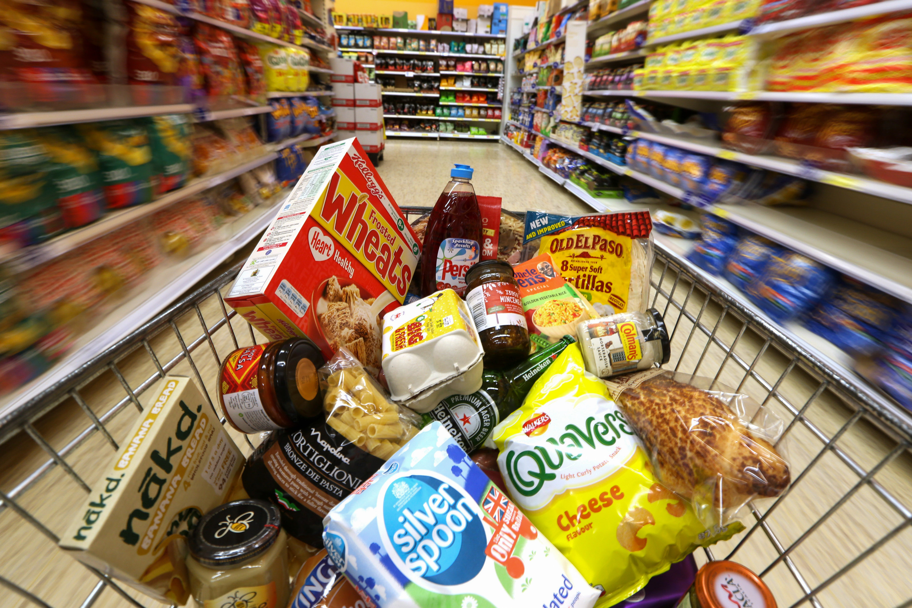
Notes:
Tradeoffs. Finite amount of money, have to allocation funds to rent and food, but you might have to make compromises (close to subway, hard wood floors, big windows, safe neighborhood versus fresh fruits/veggies, lots of food, name brand). Plants also make these tradeoffs with their energy.

Slide 10
Notes:
Cacti must make these tradeoffs as well, between non-reproductive structures and reproductive structures. This translates to height and flowers/fruits, two factors that influence nectarivore and frugivore interactions.

Slide 11

Intermediate flower production
Intermediate Height
Plants must make tradeoffs to maximize two mutually exclusive structures
Notes:
We believe plants will make these tradeoffs to maximize pollinator/seed disperser interactions.
Defining intermediate height as middle of equal binning of height since the distribution had no distinct breaks.
Defining intermediate flower/fruit production as 1 standard deviation from the mean flower/fruit production.

Slide 12




Slide 13
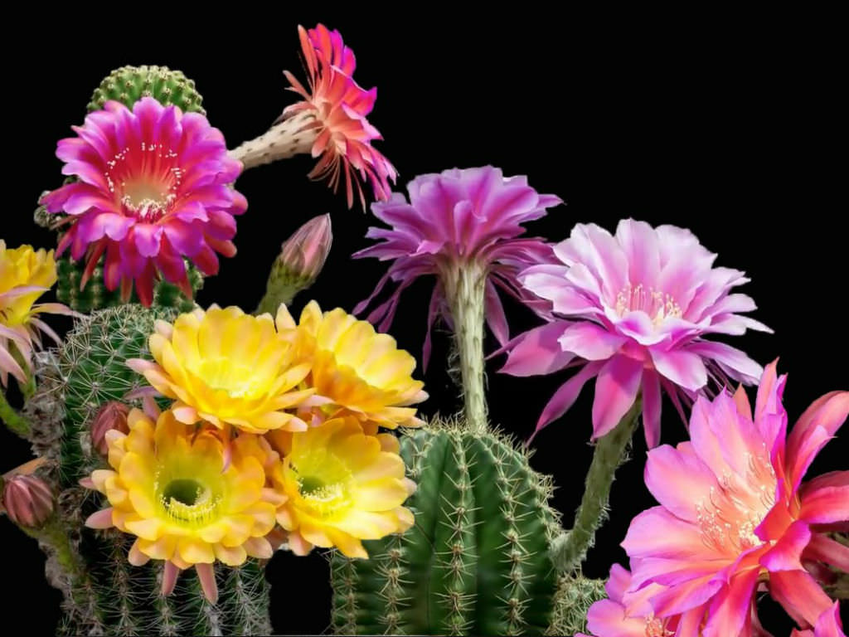
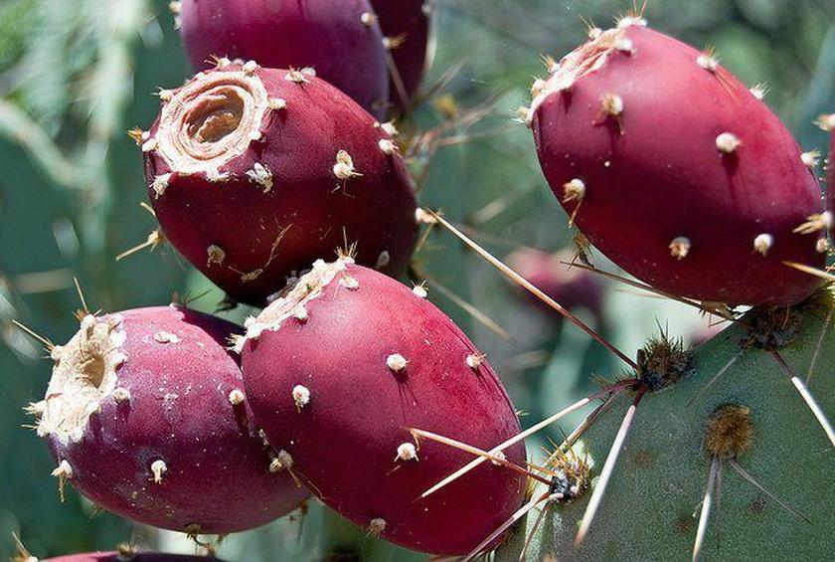
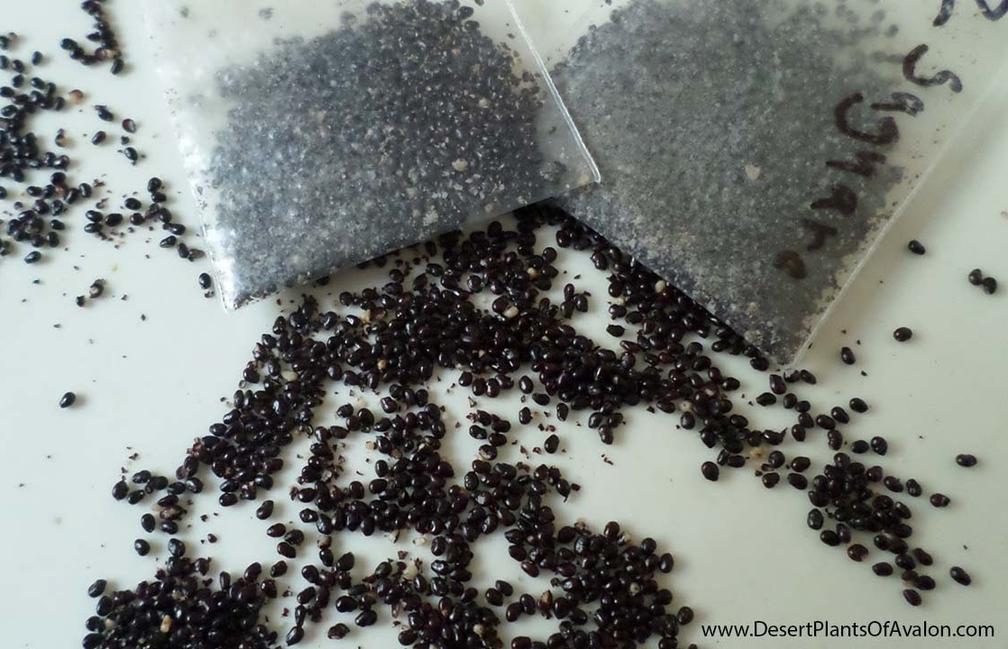
Chapter 1: A meta-analysis of allocation in Cactaceae reproductive structures
Purpose: Quantitatively examine the relationship between three different reproductive outputs of Cactaceae (flowers, fruits, and seeds).
?
?
Flower, fruit, seed
Notes:
Give audience a moment to read slides. TLDR: Is allocation theory justified in Cactaceae?

Slide 14
Research Questions
Are reproductive outputs in Cactaceae (flowers, fruits, and seeds) correlated?
How does Cactaceae phylogenetic distance related to reproductive output?
Where are Cactaceae reproductive studies relative to native and nonnative Cactaceae locations?
What research gaps exist in Cactaceae allocation research, and what opportunities for agro-eco interdisciplinary work have been unexplored?

Slide 15
Methods
Search | Terms | Hits | Refines
1 | cact* and allocat* | 25 | topic, last five years
2 | cact* and fruit* and size | 63 | topic, last five years
3 | cact* and seed and fruit* | 110 | topic, last five years, articles
4 | cact* and seed and size | 53 | topic, last five years
5 | fruit* and seed and size and allocat* | 69 | topic, last five years
6 | cact* and size and allocat* | 10 | topic, last five years
7 | cact* and fruit and agricultur* | 18 | topic, last five years
8 | cact* and flower* | 127 | topic, last five years
9 | cact* and flower* and agricultur* | 5 | topic, last five years
 | total | 424
Completed:
Systematic Review
Web of Science
Future:
Older papers
TRY Plant Traits database
Analyze in R package “metafor”

Slide 16
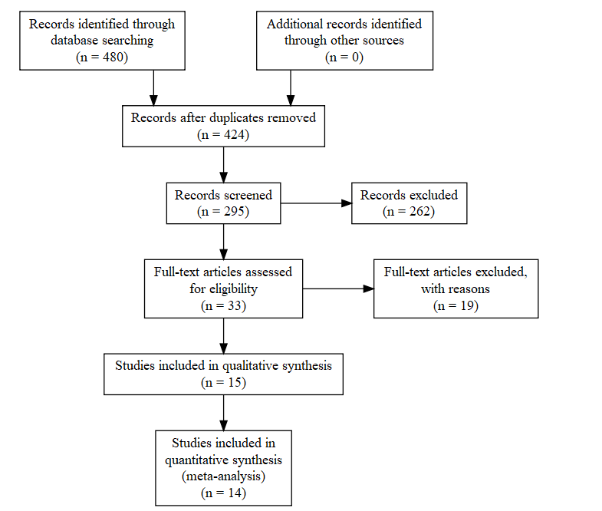

Slide 17
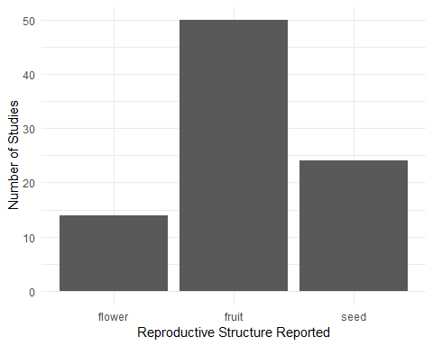
Preliminary Results
50
40
30
Number of Studies
20
10
0
flower
fruit
seed
Reproductive Structure Reported
Notes:
Fruit is the most frequently reported reproductive structure, but I believe adding “Flower” to search terms will drastically increase the number of reported flowers

Slide 18
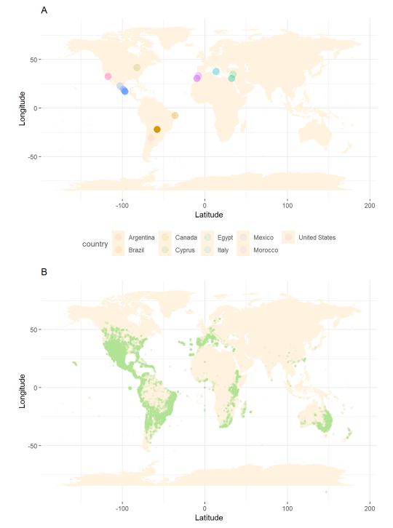
Preliminary Results
Notes:
Cacti are native to western hemisphere (except for one species in Africa), but introductions have created invasive species, and agricultural products have made the family present globally.

Slide 19
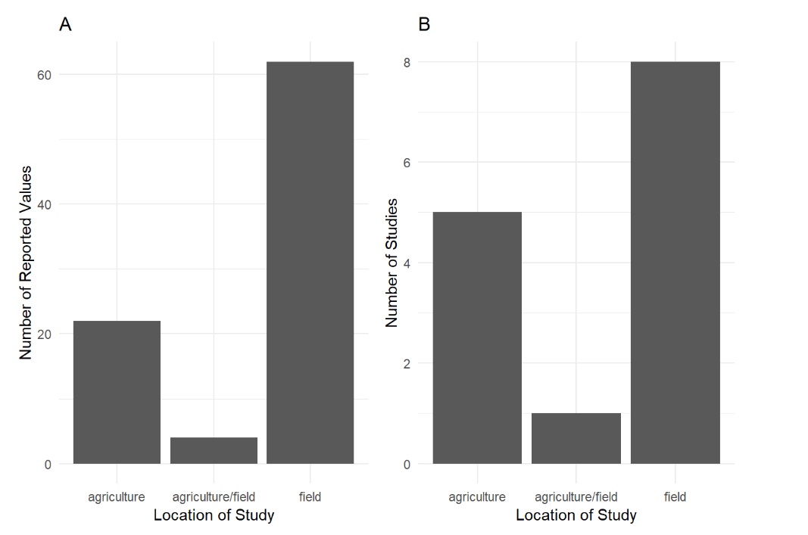
Preliminary Results
A
B
60
8
6
40
Number of Reported Values
Number of Studies
4
20
2
0
0
Agriculture Agriculture/field Field
Agriculture Agriculture/field Field
Location of Study
Notes:
Most studies are relevant to agricultural and ecological sciences, but there is little overlap in subdisciplines. From the systematic review, methodology differs significantly between disciplines. With this part of my project, I’d like to work towards bridging the gap between these two fields.

Slide 20
Chapter 2: Linking Avian Double Mutualistic Interactions to Cactaceae Seed Dispersal and Facilitation
Purpose: The aim of this study is to determine the frequency of this double mutualistic, facilitation-inducing interaction between birds and a foundational species of cactus based on morphological characteristics of cactus individuals.
Notes:
Give audience a moment to read the slides. TLDR: Describe the interaction between birds and C. acanthocarpa.

Slide 21
Research Questions
1. Are reproductive structures of cacti correlated with volume and other reproductive structures?
2. What Avian trophic communities are associated with C. acanthocarpa?
3. How frequent are Bird C. acanthocarpa mutualistic, facilitation-inducing interactions?

Slide 22
Hypotheses
Hypotheses: Cacti compromise on allocation to reproductive and non-reproductive structures. Presence and relative attractiveness of a cactus influences frequency of positive interactions with nectarivorous and frugivorous birds.

Slide 23
Predictions
Predictions:
1. Flower and fruit production will be positively correlated, but cactus volume and reproductive output will be negatively correlated.
2. Avian associations at a C. acanthocarpa individual is different than avian associations at the entire site.
3. Avian visitation rates and associations are dependent on cactus morphological characteristics.
Notes:
Let audience read slide

Slide 24
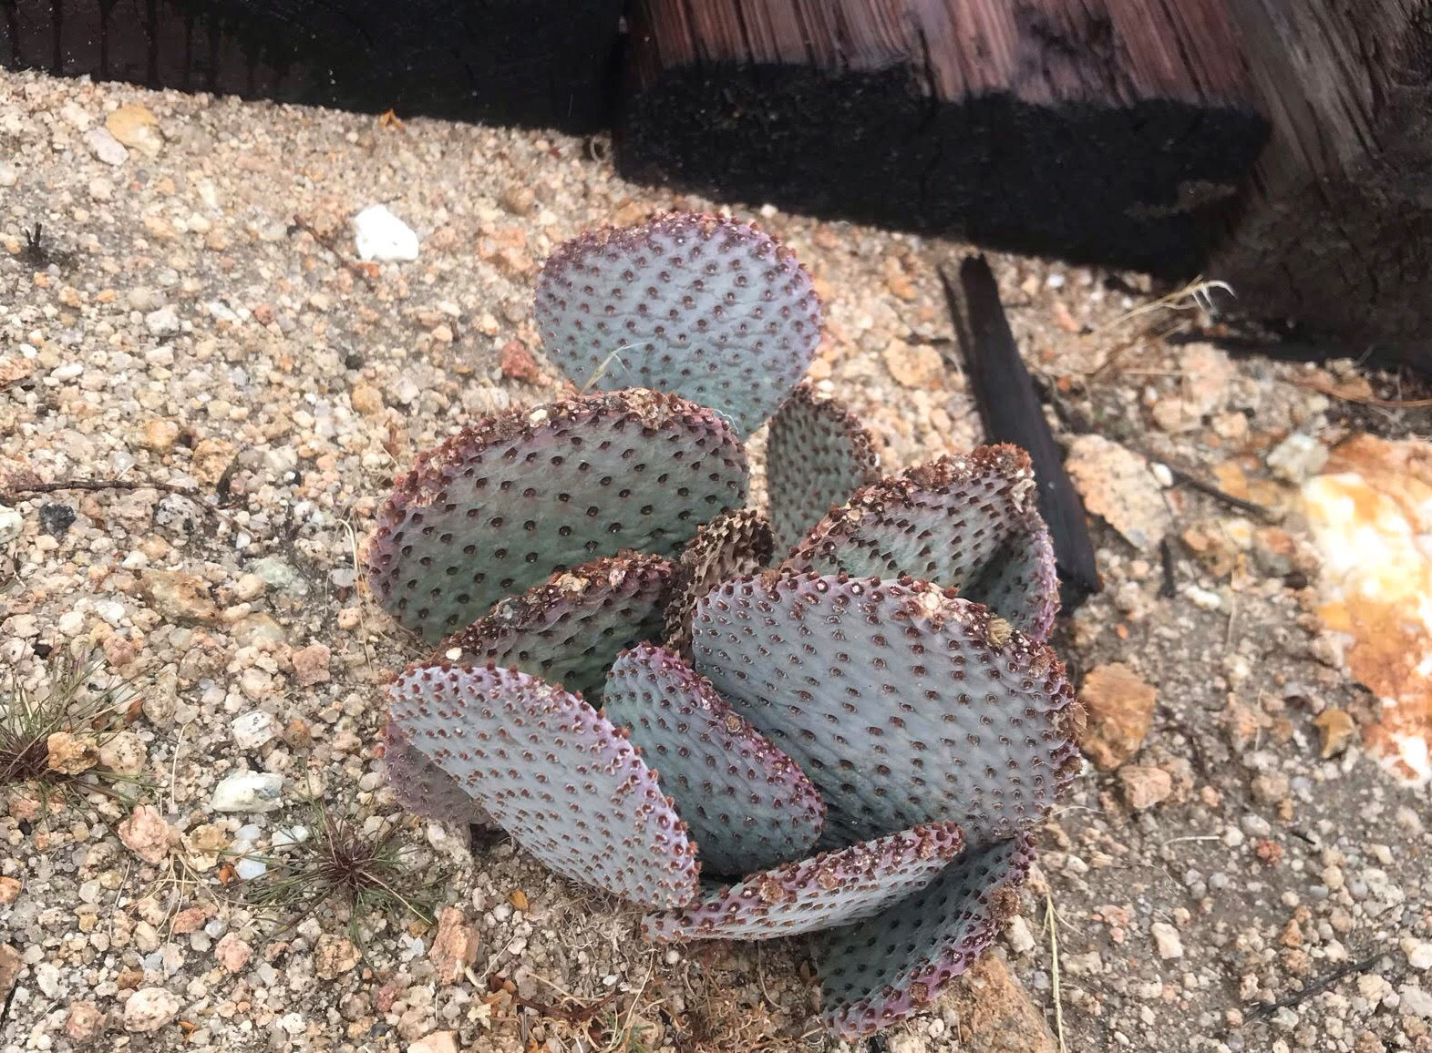
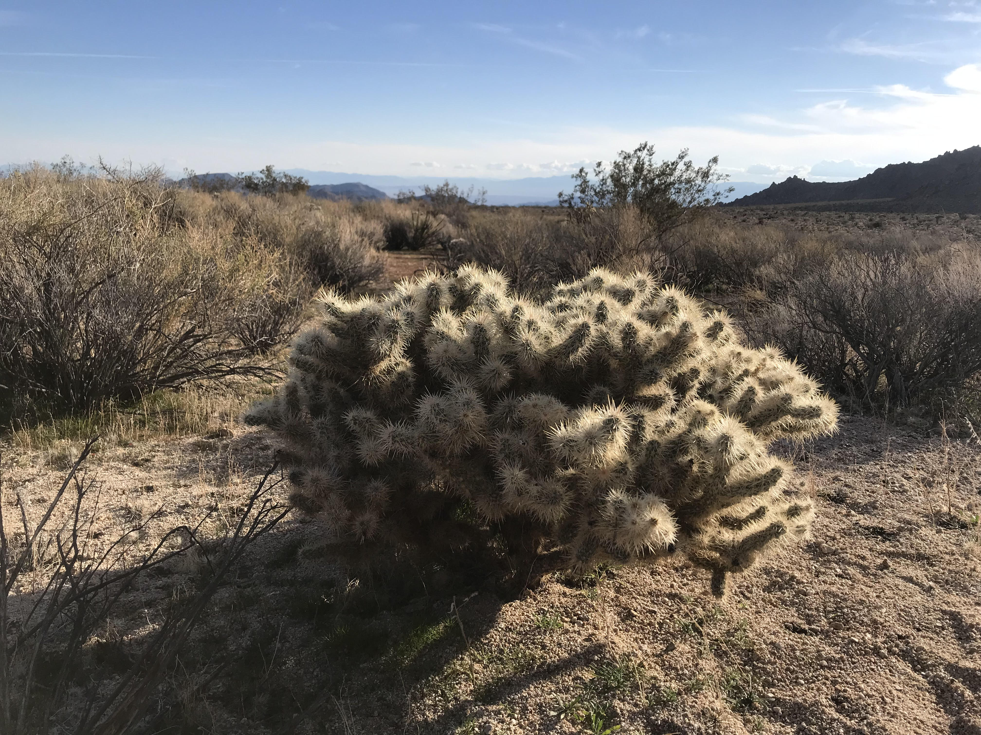
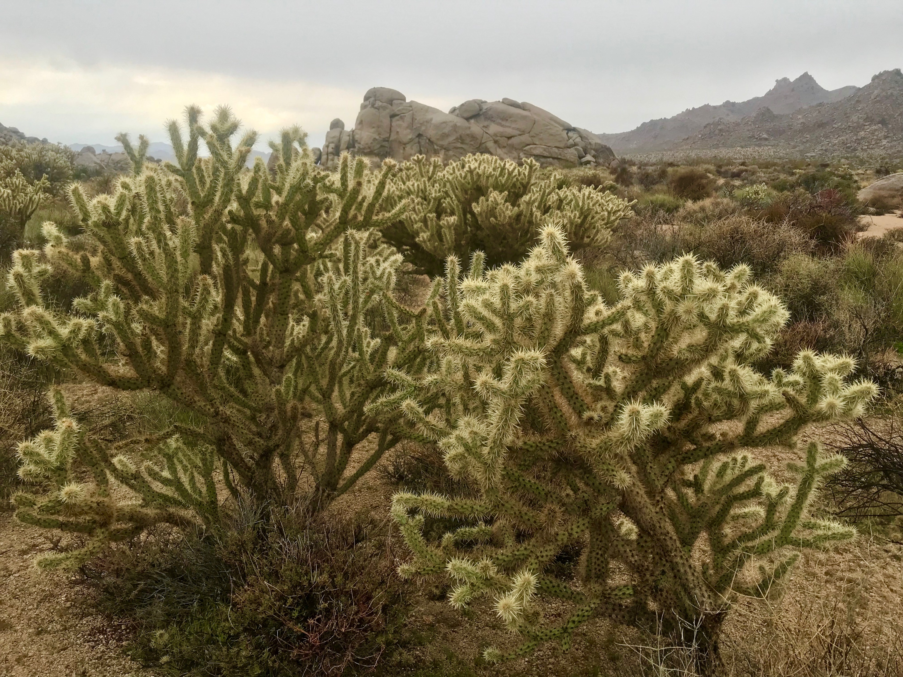
Methods: Preliminary Cactus Survey
Cylindropuntia acanthocarpa, Cylindropuntia echinocarpa, & Opuntia basilaris
Transects or haphazard
Major, minor, and vertical axes measured
Health index (1-5)
Branch death, rot, and scarification

Slide 25
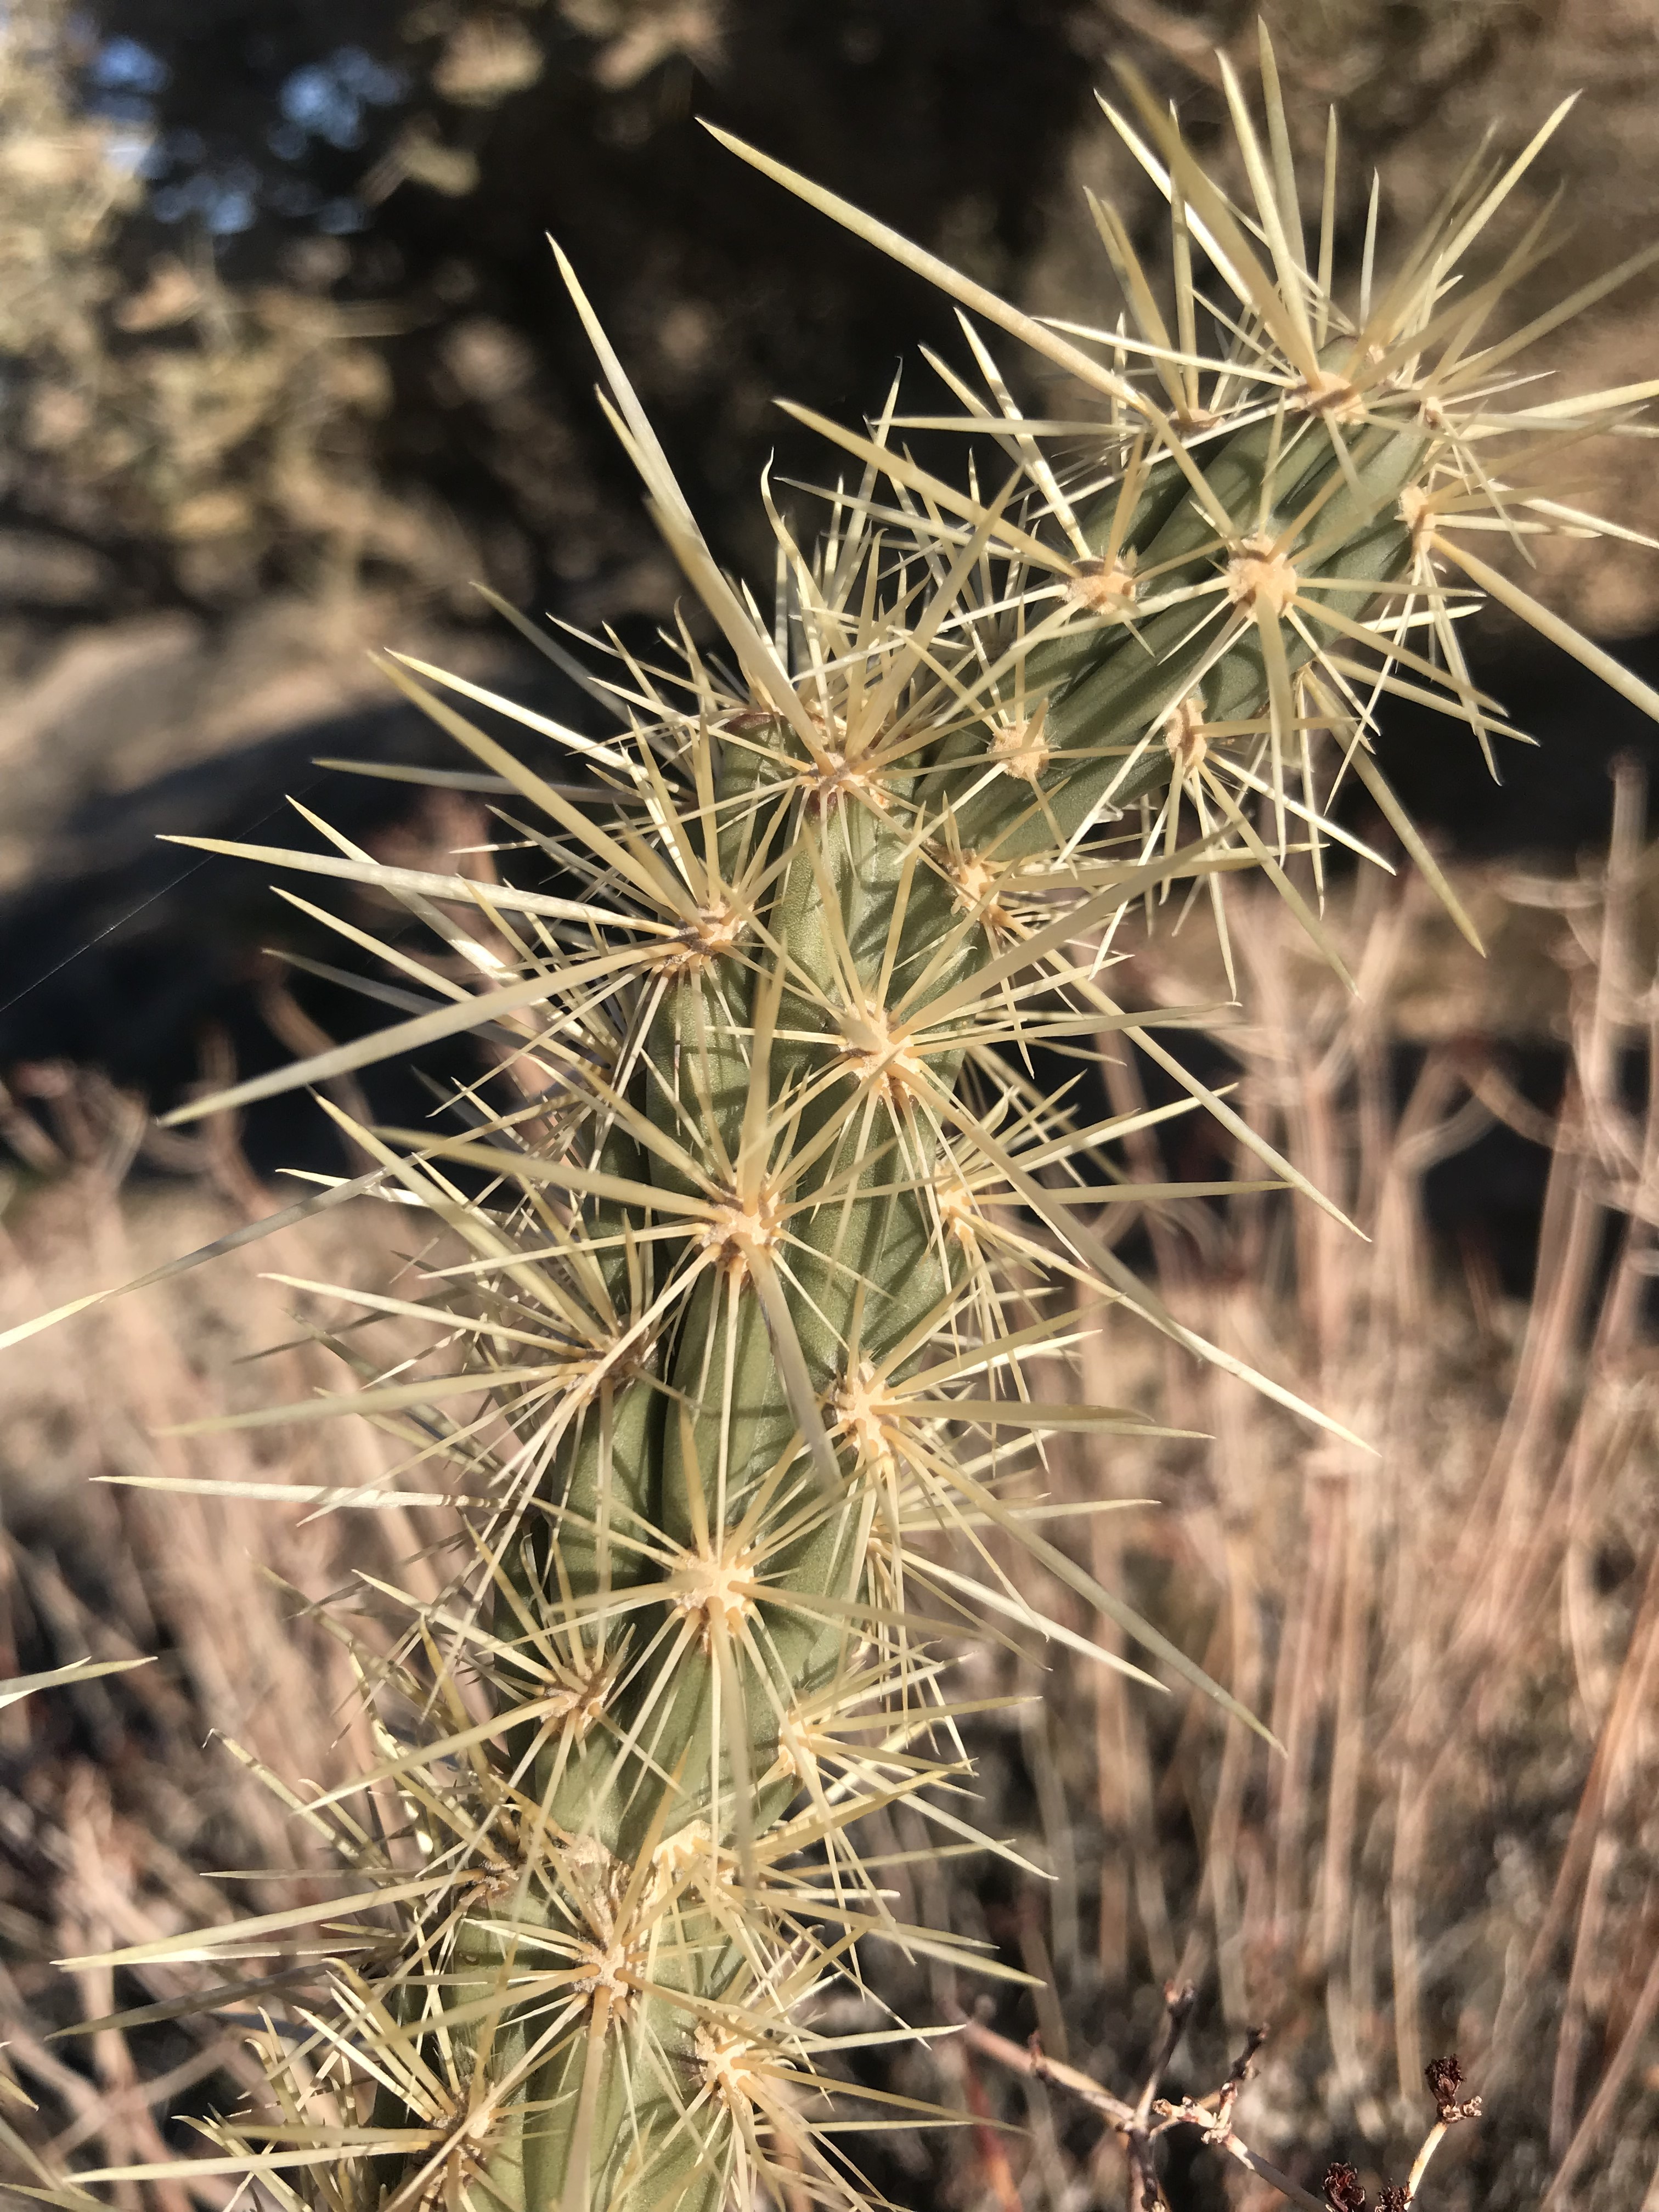
Methods: Experimental Manipulations
Cylindropuntia acanthocarpa
Small, medium, large class sizes
0%, 25%, 50%, 75%, 100% flowers or fruits removed
7 replicates (105 total cacti, 3.5 hours per day)
1 hour focal observations

Slide 26
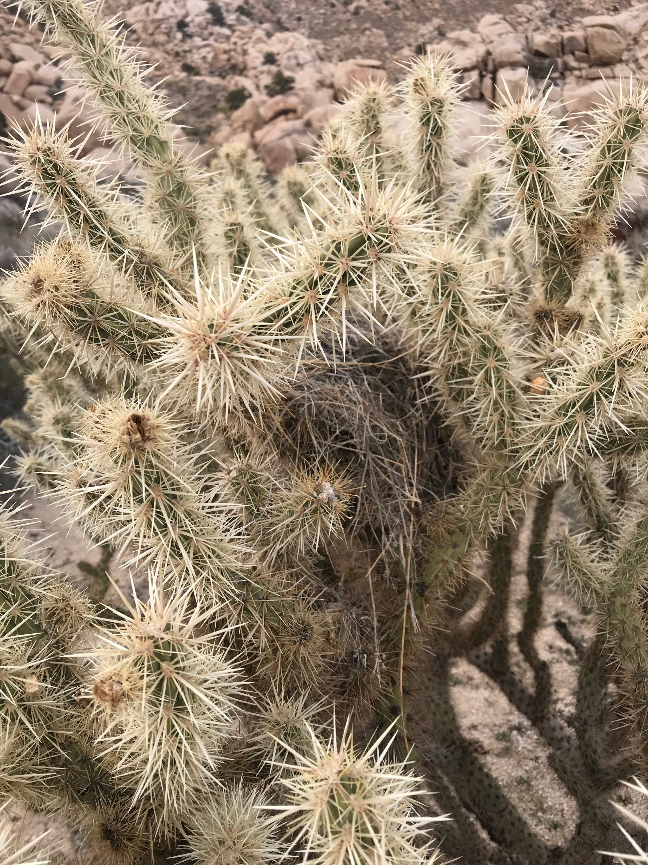
Methods: Experimental Manipulations
Ethogram
Species/behavior identification aided by 150-600mm digital camera
Measure sucrose content in flowers
Weigh fresh fruit and seeds

Slide 27
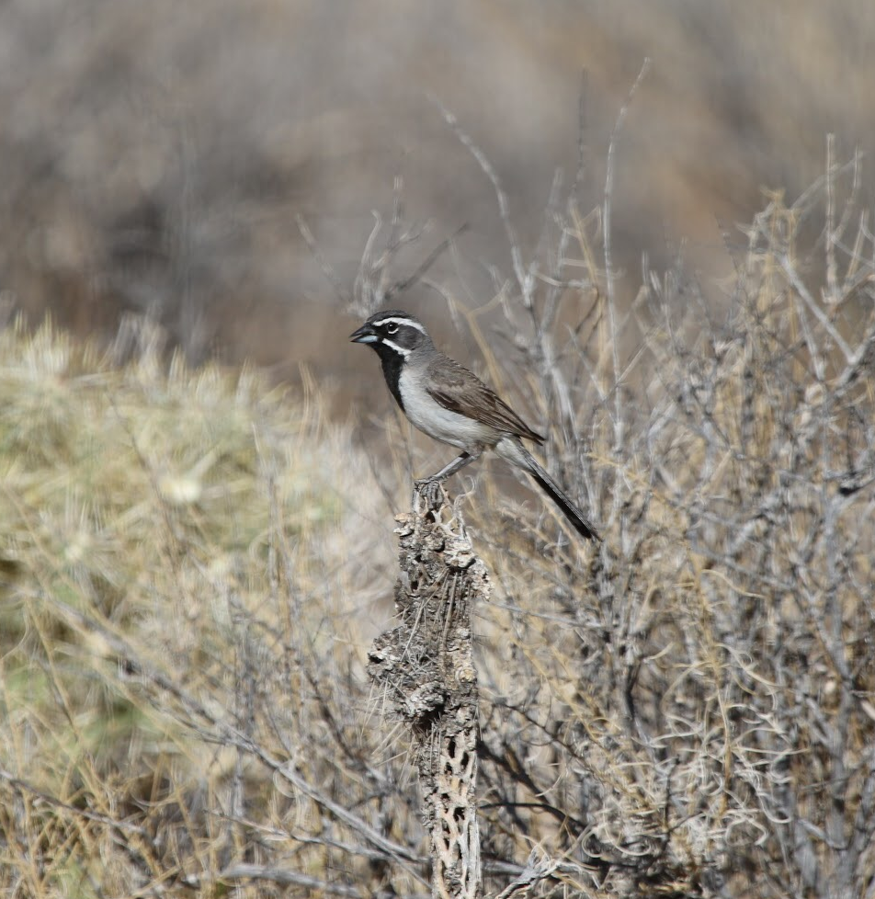
Methods: Joy Sampling
Area search
50 hours total (2 hour sessions)
Mesohabitat
Geotag
Point count
50 hours total (2 hour sessions)
Monitor one cactus
Notes:
Question: should I only monitor cacti for point count, or split into different mesohabitats? (open, shrub)

Slide 28
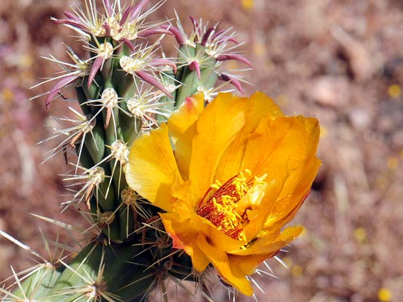
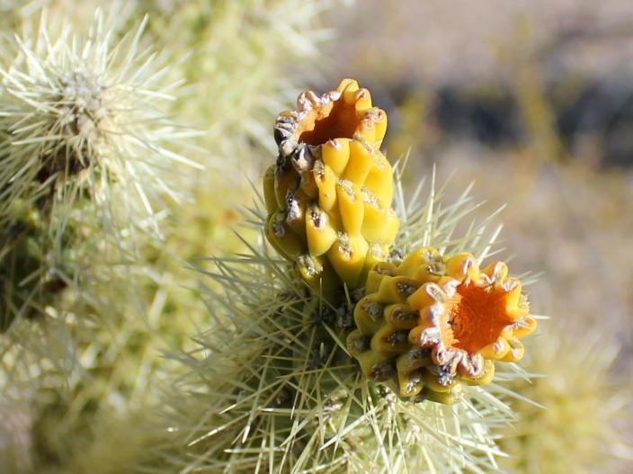
Paired Observations
20 cactus individuals
Geotag
Count flowers in May, fruit in August
Flower, fruit
Notes:
Monitor to determine link between flowers and fruit (same indivdiuals)

Slide 29
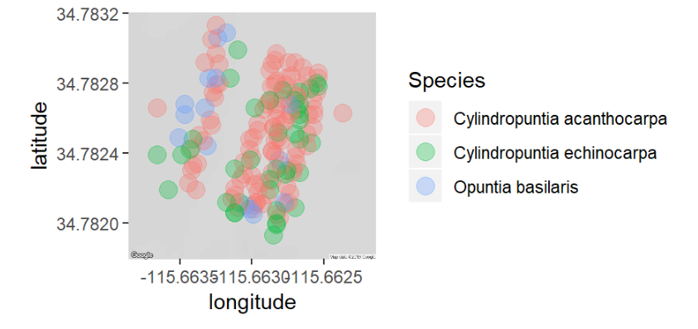
Preliminary Results: Location
Notes:
C. Acanthocarpa was most dense

Slide 30
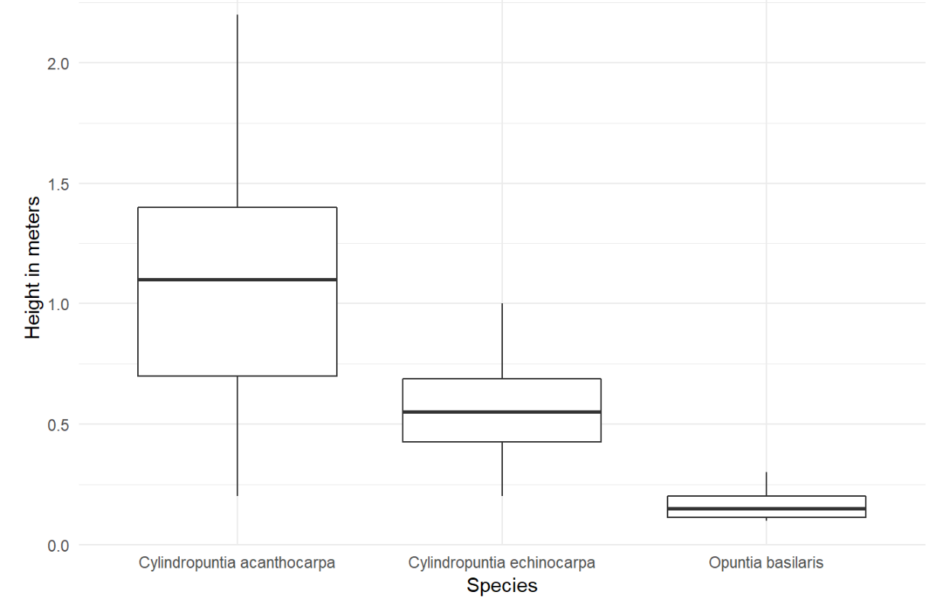
Preliminary Results: Size
Kruskal-Wallis, Chi-square = 3.71, p > 0.0001, df = 52
Means heights of 1.04 meters for C. acanthocarpa, 0.55 meters for C. echinocarpa, and 0.17 meters for O. basilaris
0.0 0.5 1.0 1.5 2.0
Height in meters
Cylindropuntia acanthocarpa
Cylindropuntia echinocarpa
Opuntia basilaris

Slide 31
Preliminary Results: Size Class
Species | Small | Medium | Large
Cylindropuntia acanthocarpa | <85cm | 86cm - 152cm | >153cm
Cylindropuntia echinocarpa | <45cm | 46cm - 72cm | >73cm
Opuntia basilaris | <15cm | 16cm - 22cm | >23cm
Notes:
C. Acanthocarpa had the widest size classes. This is important bc it may more clearly translate to how birds are viewing differences in size

Slide 32
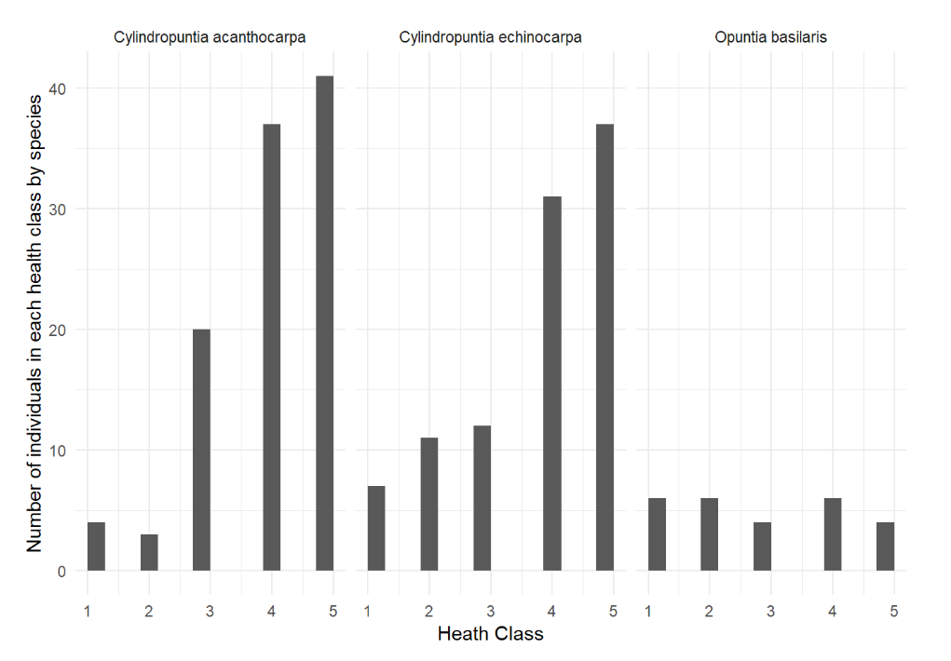
Preliminary Results: Health
Cylindropuntia acanthocarpa
Cylindropuntia echinocarpa
Opuntia basilaris
Pearson’s Chi-squared Test, X-squared = 27.325, df = 8, p > 0.001
Number of individuals in each health class
0 10 20 30 40
 | 1 | 2 | 3 | 4 | 5
C. acanthocarpa | 4 | 3 | 20 | 37 | 41
C. echinocarpa | 7 | 11 | 12 | 31 | 37
O. basilaris | 6 | 6 | 4 | 6 | 4
1 2 3 4 5 1 2 3 4 5 1 2 3 4 5
Health Class

Slide 33
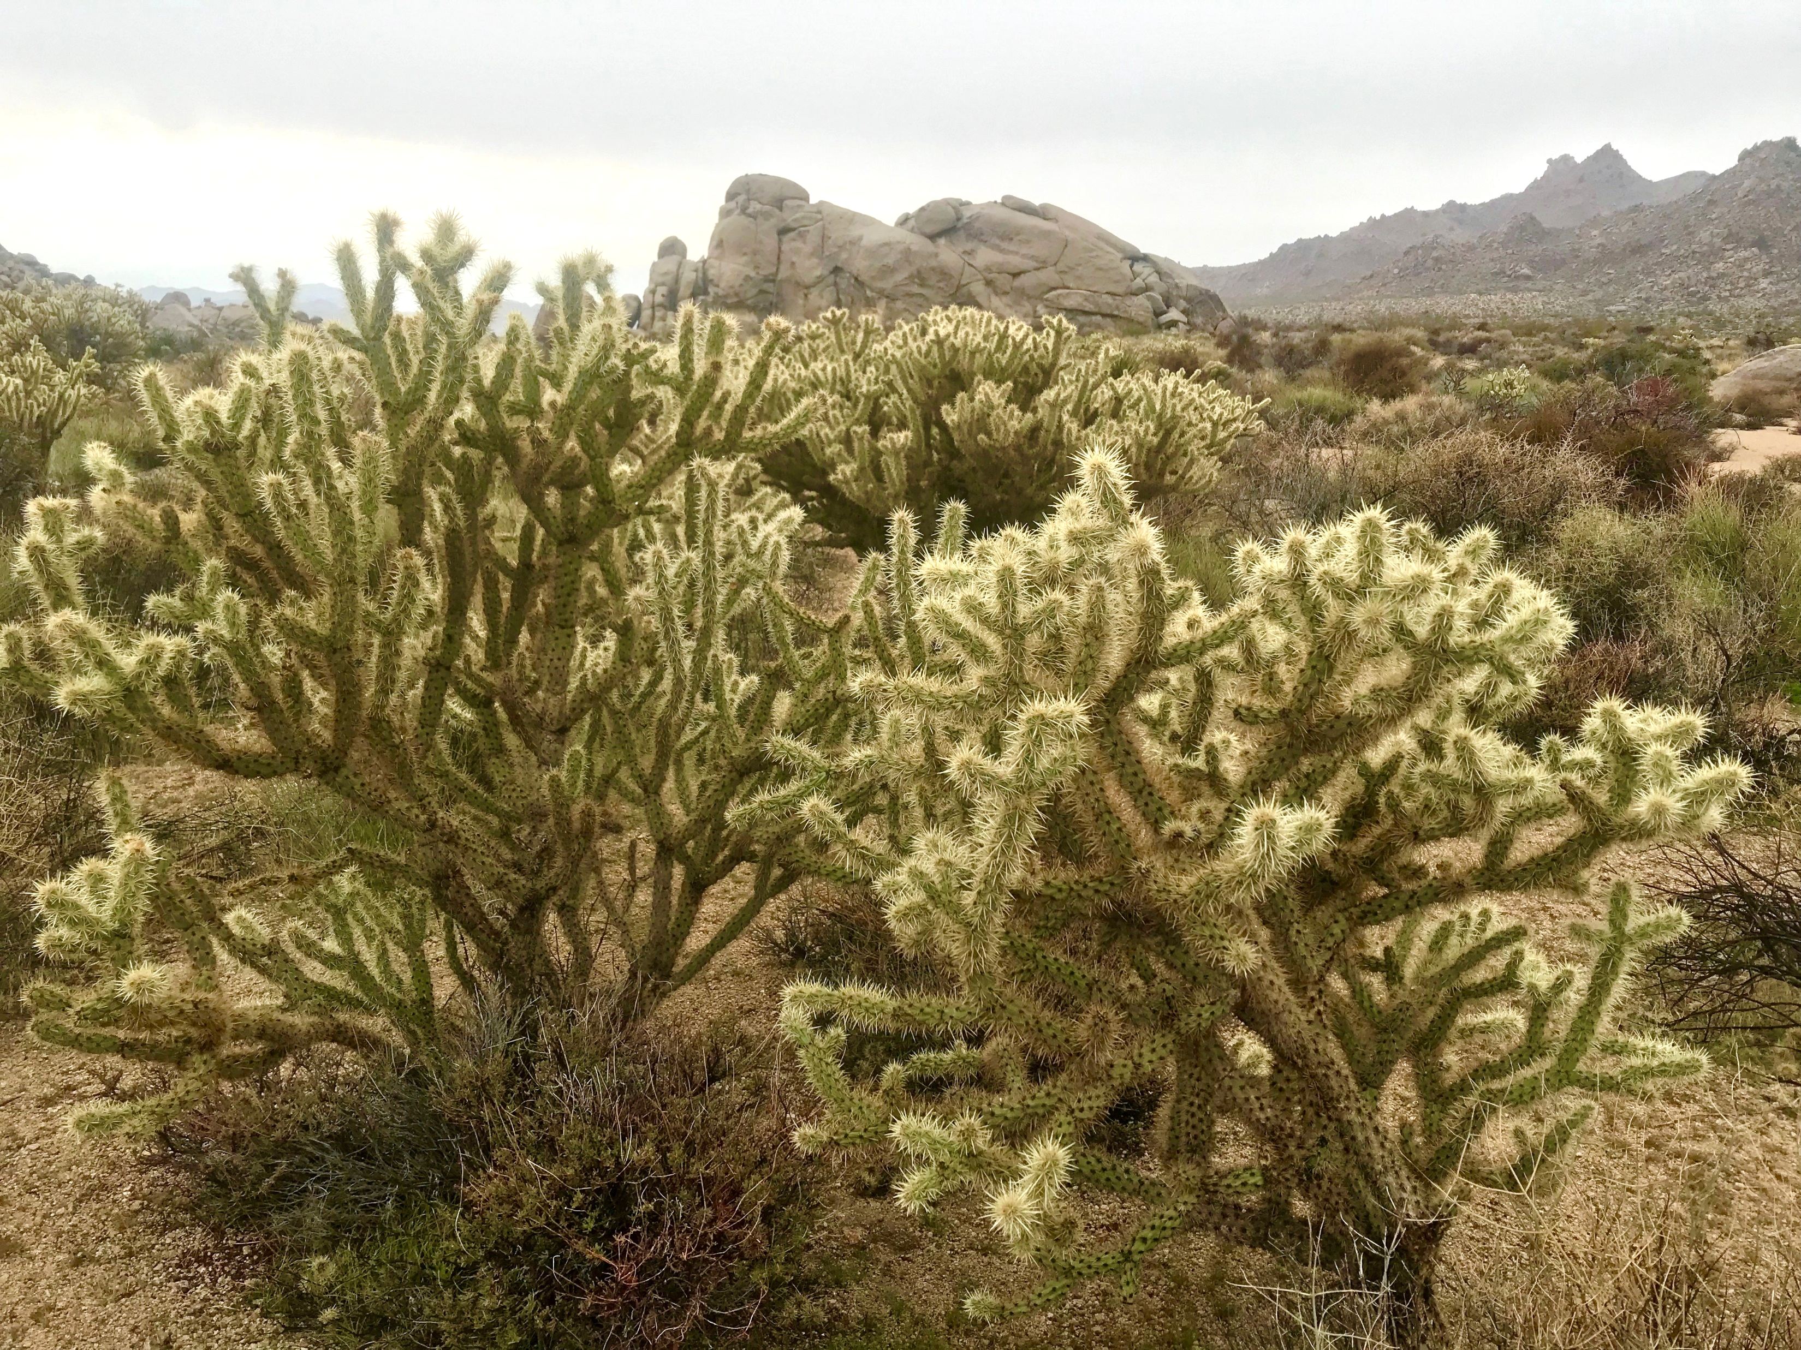
Discussion
Abundance, size, and health were “strongest” in C. acanthocarpa
One study species > three study species
Likely foundational species
Notes:
We need abundance for replications in May and August, size to translate to birds, and health to encourage strong flowering

Slide 34
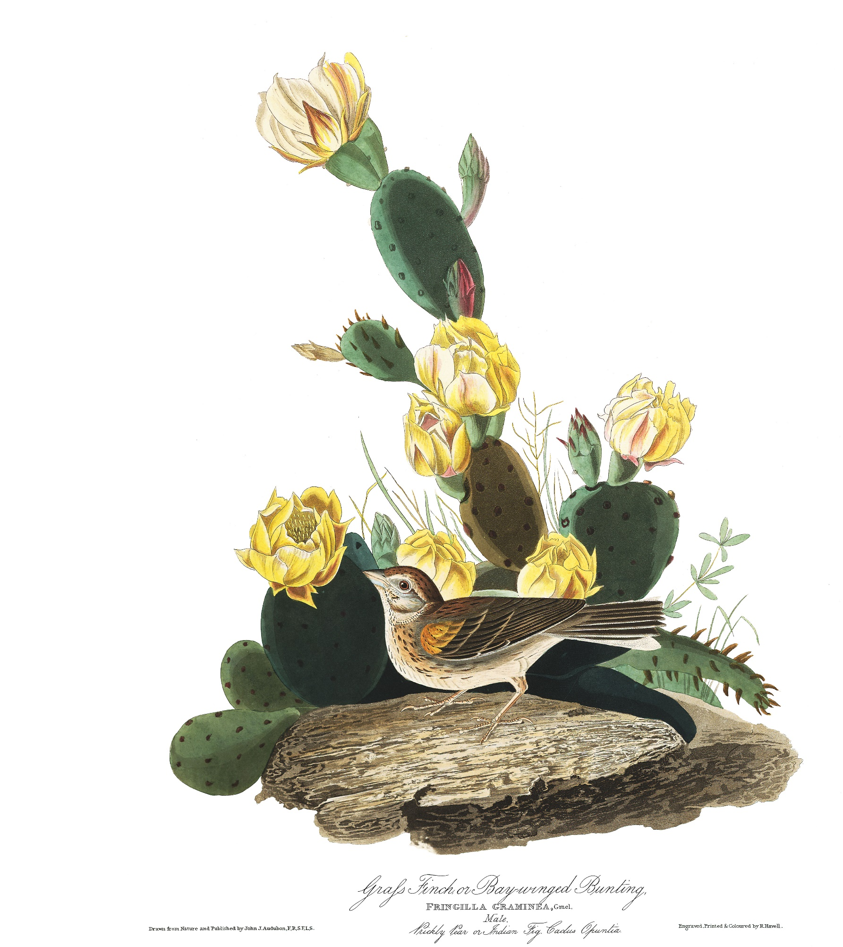
Looking forward
Mega-bloom year
C. acanthocarpa facilitation experiments
Shrub/cactus mapping
Notes:
Mega bloom year bc high rain means lots of cactus flowers, some cool oppurtunties in that
Follow up with pollinator facilitation experiments by Jenna two years ago during last mega bloom, but now during cactus blooming instead of annual blooming
Map all cacti and shrubs at Sunset cove (undergrad help)

Slide 35
If we understand:
Positive Interactions
Habitat Structure
Restoration/Protection of Deserts
Notes:
Deserts are diverse (not wastelands) in decline bc climate change, human development, and invasive species. All Cactaceae are listed on CITES Appendix II, with several ssp on Appendix I.
This project will help us understand how positive interactions influence habitat structure, and therefore combat habitat loss.
Restoration work has primarily focus on abiotic factors of habitat structure, but if we can identify biotic vectors of habitat creation and maintanence, this project potentially has the capacity to revamp the toolbox available to practioners.

Slide 36
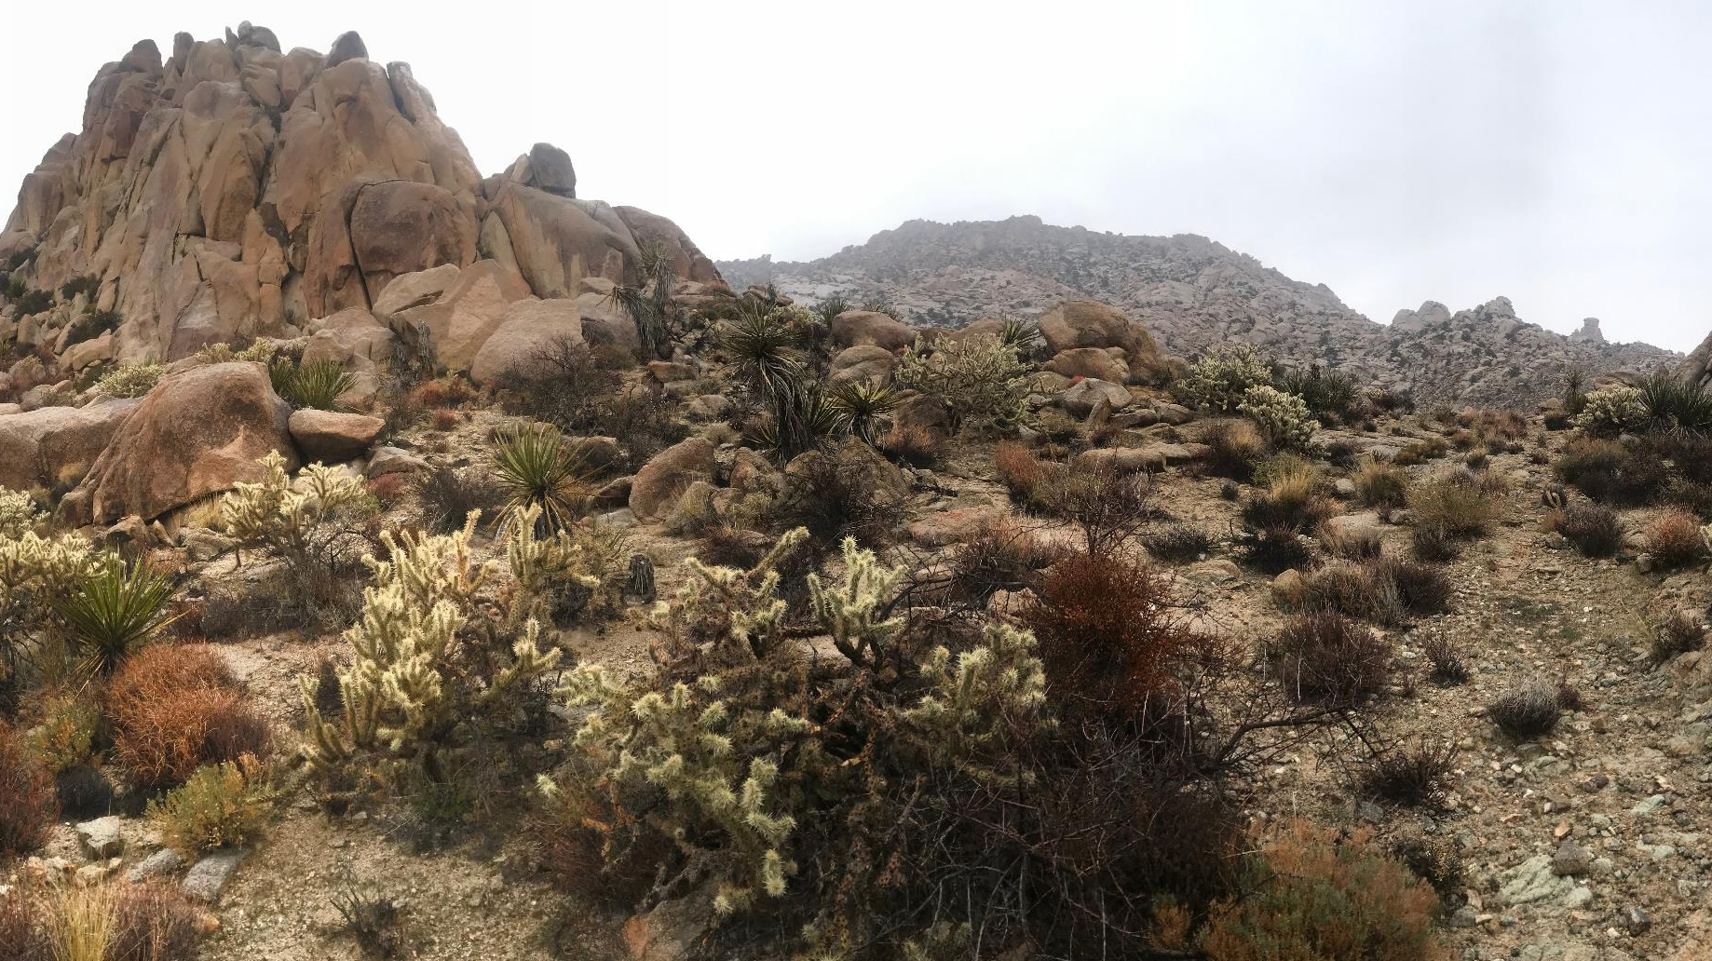
Thanks for listening!

